Slide 1
Relational Model
SECD2523 Database
Semester 1 2021/2022

Slide 2
Learning Objective
At the end of this module, students should be able to explain and describe:
  Terminology of relational model.
  How tables are used to represent data.
  Properties of database relations.
  How to identify candidate, primary, foreign keys.
  Meaning of entity integrity and referential integrity.
  Purpose and advantages of views.

Slide 3
Introduction
First generation (hierarchical, network DBMS) – 1960s
Second generation (relational DBMS (RDBMS))
– late 70s
Third generation
(Object-oriented DBMS, Object-relation DBMS)
DBMS generations:
RDBMS is based on relational data model concepts by E.F. Codd (1970)
Simple logical structure
Sound theoretical foundation
Data is logically structured within relations

Slide 4
Relational Model Terminology
A relation is a table with columns and rows.
  Only applies to logical structure of the database, not the physical structure.
Attribute is a named column of a relation.
Domain is the set of allowable values for one or more attributes.

Slide 5
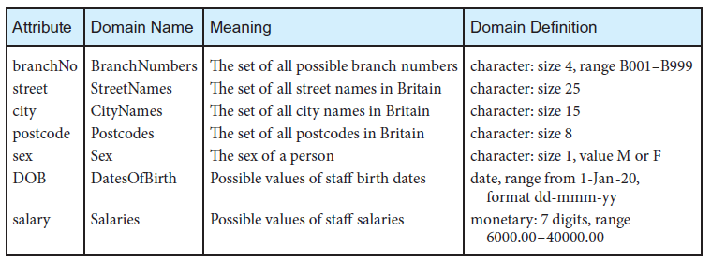
Examples of Attributes & Domains

Slide 6
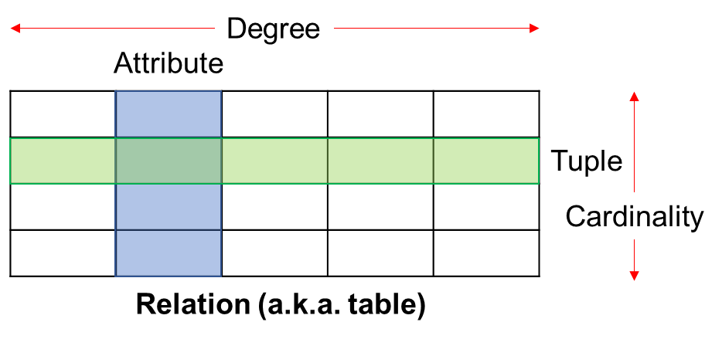
Relational Model Terminology
Tuple is a row of a relation.
Degree is the number of attributes in a relation.
Cardinality is the number of tuples in a relation.
Relational Database is a collection of relations that is appropriately structured (normalized) with distinct relation names.

Slide 7
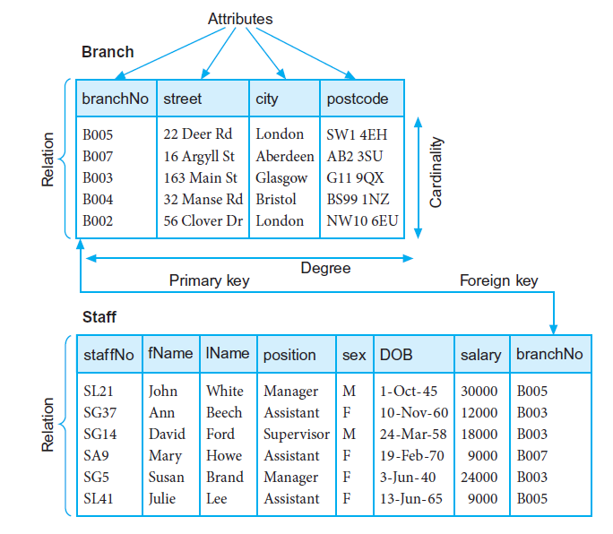
Examples

Slide 8
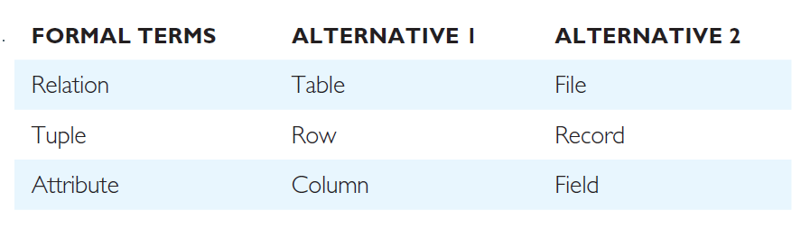
Alternative Terminology
Table: Alternative terminology for relational model terms

Slide 9
Database Relations
Relation schema
  Named relation defined by a set of attribute and domain name pairs.
  Common convention:
    RelationName (attribute_1, attribute_2,….., attribute_n)
    Example: Branch (branchNo, street, city, postcode)
Relational database schema
  Set of relation schemas, each with a distinct name.
Relation instance
  A tuple at a specific moment of time
  Eg: (B005, 55 Jln Dobi, Johor Bahru, 80100)

Slide 10
Properties of Relations
Relation name is distinct from all other relation names in relational schema.
Each cell of relation contains exactly one atomic (single) value.
Each attribute has a distinct name.
Values of an attribute are all from the same domain.
Each tuple is distinct; there are no duplicate tuples.
Order of attributes has no significance.
Order of tuples has no significance, theoretically.

Slide 11
Relational Keys
Relational keys
  One or more attributes in a relation that uniquely identifies each tuple in a relation
  Types:
    Superkey
    Candidate key
    Composite key
    Primary key
    Alternate key
    Foreign key

Slide 12
Relational Keys
Superkey
  An attribute, or a set of attributes, that uniquely identifies a tuple within a relation.
Identify superkeys that contain only the minimum number of attributes necessary for unique identification

Slide 13
Relational Keys
Superkey example:
  Branch (branchNo, street, city, postCode)
  Each branch has a unique branch number
  What is/are superkey(s) for relation Branch?
    Analyze each attribute singularly, given a value for the attribute, determine whether a unique tuple can be derived from the relation → if so, then attribute is a superkey
    If none of the attribute (singularly) can be a candidate key, then try to combine two (or more) attributes and determine whether the combined attributes can derive a unique tuple → if so, then the combined attributes is a superkey.

Slide 14
Relational Keys
Candidate Key
  A superkey such that no proper subset is a superkey within the relation.
Two properties:
  In each tuple of relation R, values of K uniquely identify that tuple (uniqueness).
  No proper subset of K has the uniqueness property (irreducibility).
If subset of K is a superkey itself, then K is not a candidate key
There can be more than one candidate keys in a relation

Slide 15
Relational Keys
Example (candidate key - CK):
  Assume we have this list of superkeys for a relation. Determine whether these superkeys are candidate keys.
    branchNo
    branchNo, city
    postCode, branchNo
    1st superkey → branchNo
      This superkey has no subset that is a superkey itself, hence branchNo is a CK
    2nd superkey → branchNo, city
      This superkey has a subset that is a superkey itself (i.e. branchNo), hence branchNo, city is NOT a CK
    3rd superkey → postCode, branchNo
      This superkey has a subset that is a superkey itself (i.e. branchNo), hence postCode, branchNo is NOT a CK

Slide 16
Relational Keys
Composite Key
  When a key consists of more than one attribute.
Primary Key (PK)
  The candidate key that is selected to identify tuples uniquely within the relation.
Alternate Key
  The candidate keys that are not selected to be the primary key.

Slide 17
Relational Keys
Foreign Key
  An attribute, or set of attributes, within one relation that matches the candidate key of some (possibly the same) relation.
Indicate a relationship between relations. E.g:
  Branch (branchNo, street, city, postCode)
    PK → branchNo
  Staff (staffNo, fName, lName, position, sex, DOB, salary, branchNo)
    PK → staffNo
    FK → branchNo references Branch(branchNo)

Slide 18
Relational Keys
Superkey
Candidate Key
Primary Key
Foreign Key

Slide 19
Recap on the example

Slide 20
Integrity Constraints
Integrity constraints are to ensure correctness / accuracy of data.
  Domain constraints; integrity rules.
Integrity rules
  Constraints or restrictions that apply to all instances of the database.
  Two principal rules:
    Entity integrity
    Referential integrity

Slide 21
Integrity Constraints
Null
Represents value for an attribute that is currently “unknown” or not applicable for tuple.
Deals with incomplete or exceptional data.
Represents the absence of a value and is not the same as zero or spaces, which are values.

Slide 22
Integrity Constraints
Entity Integrity
  In a base relation, no attribute of a primary key can be null.
Referential Integrity
  If foreign key exists in a relation, the foreign key value:
    must match a candidate key value of some tuple in its home relation; OR
    foreign key value must be wholly null.
General Constraints
  Additional rules specified by users or database administrators that define or constrain some aspect of the enterprise.

Slide 23
Views
Base Relation
A named relation corresponding to an entity in conceptual schema, whose tuples are physically stored in database.
View
The dynamic result of one or more relational operations operating on base relations to produce another relation.

Slide 24
Views
A virtual relation that does not necessarily actually exist in the database but is produced upon request, at time of request.
Contents of a view are defined as a query on one or more base relations.
Views are dynamic, meaning that changes made to base relations that affect view attributes are immediately reflected in the view.

Slide 25
Purpose of Views
Provides powerful and flexible security mechanism by hiding parts of database from certain users.
Permits users to access data in a customized way, so that same data can be seen by different users in different ways, at same time.
Can simplify complex operations on base relations.

Slide 26
Updating Views
All updates to a base relation should be immediately reflected in all views that reference that base relation. If view is updated, underlying base relation should reflect change.
There are restrictions on types of modifications that can be made through views:
  Updates are allowed if query involves a single base relation and contains a candidate key of base relation.
  Updates are not allowed when query involves multiple base relations.
  Updates are not allowed when query involves aggregation or grouping operations.

Slide 27
Summary
Terminologies – relation, relational schema
Keys – super key, candidate key, composite key, primary key, foreign key, alternate key
Integrity constraint
View

